Slide 1

WHEREVER, WHENEVER
flexit@flexit.fit
www.flexit.fit
Spring 2018
Confidential & Proprietary
Notes:
FONTING: we’re using nexa bold here, but glacial indifference elsewhere. Thoughts?
1AA6C9
A5A5A6

Slide 2

OPPORTUNITY | SOLUTION | BUSINESS
The fitness industry is ripe with opportunity, and the traditional gym membership model is prime for disruption
$21.8B
Rev/year of the gym and health club industry
57.25 m
Members of health clubs in the United States
67%
Of people with gym memberships never use them
$39
Per gym membership is wasted due to underutilization
Source: Statista, The Statistics Portal - 2016
Notes:
Other potential taglines:
The Fitness space is under attack by the needs of the dynamic customer
Trends in the fitness space are disrupting the status quo
The fitness space is facing disruption driven by the
Traditional gym models are under attack by the evolving needs of the customer

Slide 3

OPPORTUNITY | SOLUTION | BUSINESS
OPPORTUNITY | SOLUTION | BUSINESS
The traditional gym model is not in sync with today’s gym-goer
Boutique fitness has conditioned pay-as-you-go consumption that is not compatible with the traditional gym model
Pay-as-you-go consumption has conditioned a value driven culture that is not compatible with monthly gym memberships
Value culture necessitates transparency, which runs counter to the paying for unused time
Digitally connectivity and seamless experiences are more important than ever
Experiential integration is synonymous with personalized experiences that may not be fulfilled by one fitness facility
Flexible arrangements are imperative in a world that is increasingly noisy and commitment-phobic
Convenience and community are driven by interconnected, shared experiences
Notes:
Cost savings, pay for what you use and do waste money
Lets emphasize the consumer pain point, its not as clear as it should be
Punch up importance of value and transparency

Slide 4
OPPORTUNITY | SOLUTION | BUSINESS
Gyms face significant challenges in meeting their customers’ needs while navigating an increasingly competitive landscape
High costs to launch and operate facilities requires effective sales capabilities to attract and retain profitable customers
Proliferation of gyms increases competition and requires laser focus on the needs of the customer
Increasingly transient customer base requires a broad-reach enabled by a strong digital presence to capture the available market
Expectations for personalized services are costly and complex to deliver at scale
Customer adversity to long term-commitment requires gym owners to find alternative revenue streams
Notes:
Cost savings, pay for what you use and do waste money
Lets emphasize the consumer pain point, its not as clear as it should be
Punch up importance of value and transparency

Slide 5
OPPORTUNITY | SOLUTION | BUSINESS
“… People, especially millennials, are searching for personalized experiences everywhere they go, and that includes looking for unique fitness and workout experiences with a small group of people they connect with on a personal level. Even if they’re traveling or away from home, they expect to be able to keep that routine by walking into a local boutique gym on a per-session basis or by using a digital fitness app outside, in a hotel – or almost anywhere for that matter ”
The industry is taking notice
Adam Zeitsiff, CIO - Gold’s Gym International
January 2018
“As of 2017, anywhere from 5 percent to 26 percent of fitness operators, based on their business model, indicated they engaged with digital aggregators.”
Club Industry
February 2018
“Imagine a set of tablets when you arrive, and other self-service options to streamline a large group of individuals arriving at once, with helpful service professionals available as needed”
Well + Good
April 2018
Notes:
As of 2017, anywhere from 5 percent to 26 percent of fitness operators, based on their business model, indicated they engaged with digital aggregators.
“Imagine a set of tablets when you arrive, and other self-service options to streamline a large group of individuals arriving at once, with helpful service professionals available as needed,” says Sarah Abdallah, an interior architect and designer, whose been tasked with incorporating wellness elements for clients like the Ritz-Carlton and Neuehouse, a private club and co-working space. Translation: a less frantic clamoring of leggings-clad folks scrambling to make it in time for the warm-up. “Technology can be integral in helping people make the transition from the chaotic outside world to going within,” -- “Well and Good”

Slide 6
OPPORTUNITY | SOLUTION | BUSINESS
What if…
there were a solution that offered gym users a personalized fitness experience while enabling gym facilities to deliver at scale?
Notes:
Other potential taglines:
The Fitness space is under attack by the needs of the dynamic customer
Trends in the fitness space are disrupting the status quo
The fitness space is facing disruption driven by the
Traditional gym models are under attack by the evolving needs of the customer
Align text

Slide 7
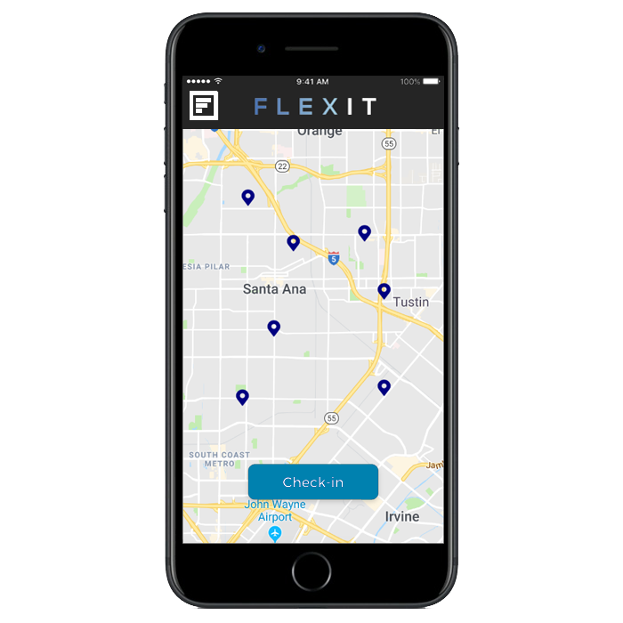
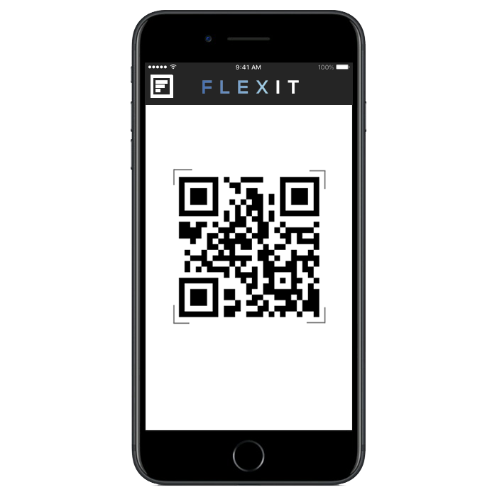
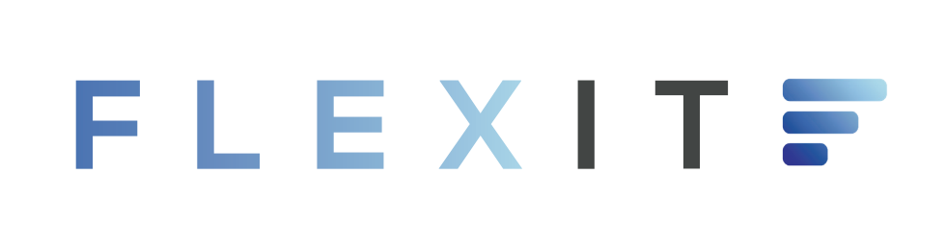
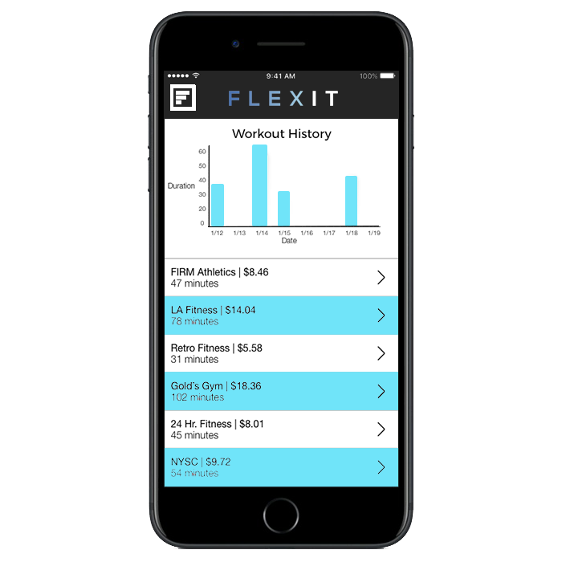
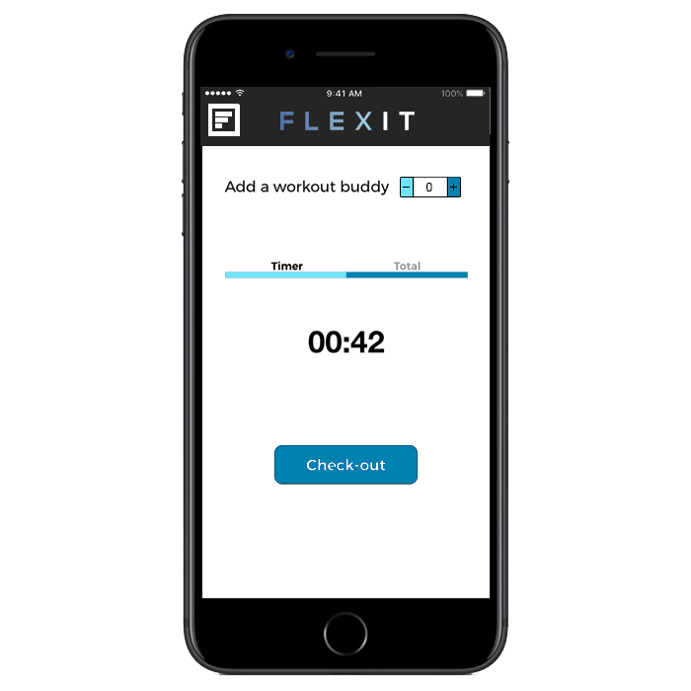
The FlexIt Customer Solution
An a-la-carte, non-membership solution to access health & fitness clubs wherever, whenever
OPPORTUNITY | SOLUTION | BUSINESS
Discover
Check-in
gyms in your community
with a quick and easy scan
THE A-LA-CARTE FITNESS SOLUTION THAT ALLOWS USERS TO WORK-OUT WHERE THEY WANT, WHEN THEY WANT AND PAY ONLY FOR THE TIME THEY USE
Review
FlexIt!
your activity and progress
using the mobile app
Notes:
Not actual screens, just visual representations.

Slide 8




Benefits To Gyms
OPPORTUNITY | SOLUTION | BUSINESS
FlexIt offers flexibility to gym-goers…
Pay for the exact time you use
Guilt and commitment free
Flexibility to workout wherever, whenever
Budget-conscious rates
Notes:
Add personal training sessions here
Nudge on overlap
1. Value and trasnperncy
2. Pay for what you use, don’t waste money
3. Variability – don’t be limited by one gym
4. Accesibility – don’t be discouraged by membership and barriers to entry
5. Community
6. Seamless experience
7. Ingration and ocnnectivity

Slide 9





Benefits To Gyms
OPPORTUNITY | SOLUTION | BUSINESS
while increasing revenue and membership for gyms
Increased revenue (via rev share)
New prospective touchpoints
Membership upticks
Increased foot traffic
Organic cross promotion and marketing
Notes:
Add personal training sessions here
No cost for facility
Easy to use
No congestion/drama at front desk
State of the art technoloy, seamless digital experience
Incremental revenue (via share)
Organoic cross promotion/marketing
Paperless
Reporting/data/metrics

Slide 10
OPPORTUNITY | SOLUTION | BUSINESS
FlexIt provides technology to scale for a growing market
2M
Serviceable obtainable market
Market Composition
40M
200M
Total available market: US Population 18-65
Serviceable addressable market: Adults who work out 2x/week
Source: Statista, The Statistics Portal - 2016
Notes:
326 in US
47.8 over 65
Under 18 74M
NEED 326 NUMBER TO NOT INCLUDE ADULTS OVER 65, NOT INCLUDE KIDS UNDER 18
DO CONCENTRIC CIRCLES, NOT THE OVAL
57.3
Need % that go to the gym less than 8x per month
Maybe concentric circles
Market comp, center align
Wrapo more evely

Slide 11
OPPORTUNITY | SOLUTION | BUSINESS
FlexIt has a sustainable approach to acquiring customers
Digital
PR
Cost: $$$
Effectiveness: High
Cost: $$$
Effectiveness: High
Social Media
Influencer
Email
Cost: $
Effectiveness: Medium
Cost: $$
Effectiveness: Medium
Cost: $
Effectiveness: Medium
Partnerships
Offline
Cost: $$
Effectiveness: Low
Cost: $
Effectiveness: Low
Notes:
Lets add affiliate programs in here, will be very important! Add to middle tier (rewards etc)
Thinking about eliminating the cost/effectiveness thing?

Slide 12
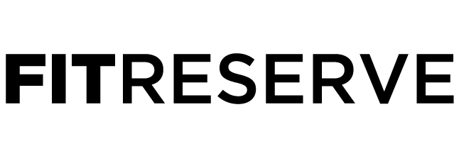








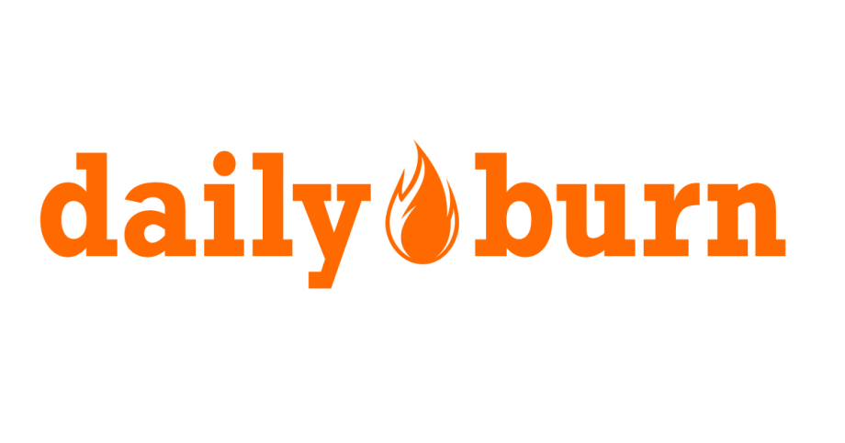




An a-la-carte, non-membership solution to access health & fitness clubs wherever, whenever
OPPORTUNITY | SOLUTION | BUSINESS
FlexIt is more affordable and experiential than its competition
Flexible
Expensive
Affordable
Inflexible
Notes:
Not actual screens, just visual representations.
Expand it out
ADD SOMETHING BOTTOM LEFT AND BOTTOM RIGHT – RETRO BOTTOM RIGHT? WHAT BOTTOM LEFT?

Slide 13
OPPORTUNITY | SOLUTION | BUSINESS
What about the platform’s risks?
Risks
Mitigants
Consumer Risk
None
Gyms feel threatened by potential loss of membership to pay-as-you-go format
FlexIt will drive trial to gyms from new customers that will create lead generations for new memberships and offset any loss of memberships
Loss of revenue from foregone memberships
Added rev-share opportunities for gyms with pay-as-you-go customers
Competition from gym day passes and other class-oriented tech platforms
Day passes are cumbersome and not as affordable as FlexIt’s streamlined and convenient offering. Eventually FlexIt will replace day passes
User churn that happens naturally as some customers stop going to the gym
Tech platform provides opportunities to engage customers on a regular basis to prevent them from slipping in their workout routines
Notes:
To consumers → no obvious risk
MAIN RISK : GYM OWNERS LOVE THE GUYS WHO DON’T GO AND PAY AND NEVER GO – CANNIBALIZATION – BE SENSITIVE – “only reason gyms survive is big population who pay high membership rates and don’t use it” and if cannbailized it then would be a big risk
BARRIER TO ENTRY ISNT HIGH : AND CALSSPASS HAS GYM TIME
Omar says takeaway by fitness industry – educated ppl in urban places who are tech forward with more money, and then u have ppl and gym owners etc who is some guy who played baseball I ncollege and is very offline type of person and has paper sign in sheets and is very non digital and technical. From consumer base standpoint omar concern is ppl like us may have classpass
Thinks its one tap on classpass

Slide 14
OPPORTUNITY | SOLUTION | BUSINESS
FlexIt has an aggressive plan for scaling its gym portfolio
FYE JUNE | FY2019 | FY2020 | FY2021 | FY2022 | FY2023
Gyms on FlexIt | 240 | 840 | 2,040 | 3,840 | 6,240
Gyms Signed Up | 220 | 600 | 1,200 | 1,800 | 2,400
Notes:
To consumers → no obvious risk
MAIN RISK : GYM OWNERS LOVE THE GUYS WHO DON’T GO AND PAY AND NEVER GO – CANNIBALIZATION – BE SENSITIVE – “only reason gyms survive is big population who pay high membership rates and don’t use it” and if cannbailized it then would be a big risk
BARRIER TO ENTRY ISNT HIGH : AND CALSSPASS HAS GYM TIME
Omar says takeaway by fitness industry – educated ppl in urban places who are tech forward with more money, and then u have ppl and gym owners etc who is some guy who played baseball I ncollege and is very offline type of person and has paper sign in sheets and is very non digital and technical. From consumer base standpoint omar concern is ppl like us may have classpass
Thinks its one tap on classpass

Slide 15
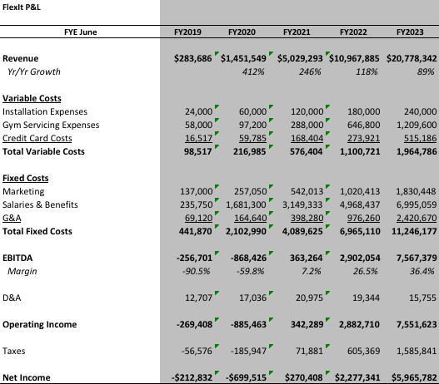
OPPORTUNITY | SOLUTION | BUSINESS
By the numbers
Notes:
57.3
Need % that go to the gym less than 8x per month
Maybe concentric circles
Market comp, center align
Wrapo more evely

Slide 16
OPPORTUNITY | SOLUTION | BUSINESS
Investment Details
Deal Terms
Uses of Capital
 | $72K | Technology | Consumer App Tablet App/Admin Panel
 | $140K | PR/Marketing | Launch/Ongoing PR Targeted Digital Strategy
 | $235K | Personnel/Ops | CTO; COO Business Development Hardware Installation Gym Training
 | $53K | Working Capital | Hardware purchase Inventory & Storage
 | $500K
Raise | Up to $500K SAFE
Valuation Cap | $2.5M Cap
Discount | 20%
Runway | 12 months
Notes:
$1M raise, $2M qualifying event, $4.5M cap
20% discount, 6% interest, 2-year maturity
Safe-Note
$1.8M cap
20% discount, 6% interest, 2-year maturity

Slide 17
OPPORTUNITY | SOLUTION | BUSINESS
Mission & Vision
FlexIt’s mission is to revolutionize access to gyms.
FlexIt will make fitness more flexible and convenient than than ever before, enabling more individuals to workout where they want, when they want.
In five years, FlexIt will accrue more minute across its platform than the largest grossing individual gym chain in the country.
Notes:
Revolutionizing the industry
The way people access fitness
ETC ETC.
To invest in flexit v a gym is a way of participating in secular trend without the capital cost.

Slide 18

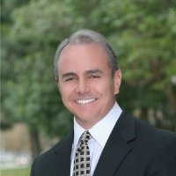
OPPORTUNITY | SOLUTION | BUSINESS
The Team
CEO – Austin Cohen
TBD – Kevin Batista
Head of Biz Dev – Michael Rojas
Sed ornare at felis vel fdasf fd. Suspendisse suscipit quam
quam facilisis, et facilispulvinar. Donec cursus efficitur mi,
Sed ornare at felis vel fdasf fd. Suspendisse suscipit quam
quam facilisis, et facilispulvinar. Donec cursus efficitur mi,
Sed ornare at felis vel fdasf fd. Suspendisse suscipit quam
quam facilisis, et facilispulvinar. Donec cursus efficitur mi,

Slide 19
WORKOUT WHEREVER, WHENEVER. JUST…
Austin Cohen
516.417.2741
austin@flexit.fit
FlexIt,Inc. Is an a-la-carte non-membership solution to access health and fitness clubs wherever, whenever. FlexIt provides on-demand access to gyms so that users can enjoy the privileges of membership without the hassle, and pay solely for the time they use.
This presentation contains forward-looking statements. In some cases, you can identify forward-looking statements by terms such as “may,” “will,” “should,” “could,” “would,” “expects,” “plans,” “anticipates,” “believes,” “estimates,” “projects,” “predicts,” “potential,” and similar expressions. Forward-looking statements involve assumptions, variables, risks, and uncertainties that may cause actual results, performance, or financial conditions to be materially different from the expectations of future results, performance or financial conditions expressed or implied in such forward-looking statements. Such factors include, but are not limited to our ability to raise capital, develop certain technologies and generate sales, and ability to expand and grow our distribution channels, changes in business plans, regulatory changes and political and economic factors. Actual outcomes and results may differ materially from what is expressed or forecasted in such forward-looking statements due to numerous risks and uncertainties. Certain information provided in this presentation comes from publicly available or third-party sources. While FlexIt, Inc. believes such information to be correct, it makes no expressed or implied representation or warranty as to the accuracy or completeness of any such information or any forward-looking statements set forth in this presentation or as to the reasonableness, accuracy, or completeness of the assumptions from which the forward-looking statements are derived. Forward-looking and all other statements made in this presentation speak only as of the date on which they are made. FlexIt, Inc. has no obligation to update or revise any information or any forward-looking statement to reflect any actual results or changes in its expectations or any change in events, conditions or circumstances on which any such statement is based. This presentation does not constitute or form an offer to sell or issue or solicitation of an offer to purchase or subscribe for any securities of FlexIt, Inc. in any jurisdiction, and no part of this presentation shall form the basis of or be relied upon in connection with any such offer or solicitation or any contract or commitment. Specifically this presentation does not constitute a “prospectus” within the meaning of the U.S. Securities Act of 1933, as amended. The contents of this presentation may not be reproduced, redistributed or passed on, directly or indirectly, to any other person or published, in whole or in part, for any purpose. © FlexIt, Inc.

Slide 20
OPPORTUNITY | SOLUTION | BUSINESS
The Team
CEO – Austin Cohen
TBD – Kevin Batista
Head of Biz Dev – Michael Rojas
Sed ornare at felis vel fdasf fd. Suspendisse suscipit quam
quam facilisis, et facilispulvinar. Donec cursus efficitur mi,
Sed ornare at felis vel fdasf fd. Suspendisse suscipit quam
quam facilisis, et facilispulvinar. Donec cursus efficitur mi,
Sed ornare at felis vel fdasf fd. Suspendisse suscipit quam
quam facilisis, et facilispulvinar. Donec cursus efficitur mi,

Slide 21

OPPORTUNITY | SOLUTION | BUSINESS
What if…
there were a solution that offered gym users a personalized fitness experience while enabling gym facilities to deliver at scale?
Notes:
Other potential taglines:
The Fitness space is under attack by the needs of the dynamic customer
Trends in the fitness space are disrupting the status quo
The fitness space is facing disruption driven by the
Traditional gym models are under attack by the evolving needs of the customer
Align text

Slide 22
An a-la-carte, non-membership solution to access health & fitness clubs wherever, whenever
OPPORTUNITY | SOLUTION | BUSINESS
FlexIt is more affordable and experiential than its competition
Flexible
Inflexible
Expensive
Affordable
Notes:
Not actual screens, just visual representations.
Expand it out
ADD SOMETHING BOTTOM LEFT AND BOTTOM RIGHT – RETRO BOTTOM RIGHT? WHAT BOTTOM LEFT?

Slide 23
An a-la-carte, non-membership solution to access health & fitness clubs wherever, whenever
OPPORTUNITY | SOLUTION | BUSINESS
FlexIt is more affordable and experiential than its competition
Flexible
Inflexible
Expensive
Affordable
Notes:
Not actual screens, just visual representations.
Expand it out
ADD SOMETHING BOTTOM LEFT AND BOTTOM RIGHT – RETRO BOTTOM RIGHT? WHAT BOTTOM LEFT?

Slide 24
An a-la-carte, non-membership solution to access health & fitness clubs wherever, whenever
OPPORTUNITY | SOLUTION | BUSINESS
FlexIt is more affordable and experiential than its competition
Flexible
Expensive
Affordable
Inflexible
Notes:
Not actual screens, just visual representations.
Expand it out
ADD SOMETHING BOTTOM LEFT AND BOTTOM RIGHT – RETRO BOTTOM RIGHT? WHAT BOTTOM LEFT?

Slide 25
An a-la-carte, non-membership solution to access health & fitness clubs wherever, whenever
OPPORTUNITY | SOLUTION | BUSINESS
FlexIt is more affordable and experiential than its competition
Flexible
Expensive
Affordable
Inflexible
Notes:
Not actual screens, just visual representations.
Expand it out
ADD SOMETHING BOTTOM LEFT AND BOTTOM RIGHT – RETRO BOTTOM RIGHT? WHAT BOTTOM LEFT?

Slide 26
OPPORTUNITY | SOLUTION | BUSINESS
FlexIt has an aggressive plan for scaling its gym portfolio
FYE JUNE | FY2019 | FY2020 | FY2021 | FY2022 | FY2023
Gyms on FlexIt | 240 | 840 | 2,040 | 3,840 | 6,240
Gyms Signed Up | 220 | 600 | 1,200 | 1,800 | 2,400
Notes:
To consumers → no obvious risk
MAIN RISK : GYM OWNERS LOVE THE GUYS WHO DON’T GO AND PAY AND NEVER GO – CANNIBALIZATION – BE SENSITIVE – “only reason gyms survive is big population who pay high membership rates and don’t use it” and if cannbailized it then would be a big risk
BARRIER TO ENTRY ISNT HIGH : AND CALSSPASS HAS GYM TIME
Omar says takeaway by fitness industry – educated ppl in urban places who are tech forward with more money, and then u have ppl and gym owners etc who is some guy who played baseball I ncollege and is very offline type of person and has paper sign in sheets and is very non digital and technical. From consumer base standpoint omar concern is ppl like us may have classpass
Thinks its one tap on classpass

Slide 27
OPPORTUNITY | SOLUTION | BUSINESS
FlexIt has a sustainable approach to acquiring customers
Digital
PR
Cost: $$$
Effectiveness: High
Cost: $$$
Effectiveness: High
Social Media
Influencer
Email
Cost: $
Effectiveness: Medium
Cost: $$
Effectiveness: Medium
Cost: $
Effectiveness: Medium
Partnerships
Offline
Cost: $$
Effectiveness: Low
Cost: $
Effectiveness: Low
Notes:
Lets add affiliate programs in here, will be very important! Add to middle tier (rewards etc)
Thinking about eliminating the cost/effectiveness thing?

Slide 28



An a-la-carte, non-membership solution to access health & fitness clubs wherever, whenever
An a-la-carte, non-membership solution to access health & fitness clubs wherever, whenever
OPPORTUNITY | SOLUTION | BUSINESS
FlexIt is more affordable and experiential than its competition
Notes:
Not actual screens, just visual representations.
Expand it out
ADD SOMETHING BOTTOM LEFT AND BOTTOM RIGHT – RETRO BOTTOM RIGHT? WHAT BOTTOM LEFT?

Slide 29

An a-la-carte, non-membership solution to access health & fitness clubs wherever, whenever
OPPORTUNITY | SOLUTION | BUSINESS
FlexIt is more affordable and experiential than its competition
Flexible
Affordable
Notes:
Not actual screens, just visual representations.
Expand it out
ADD SOMETHING BOTTOM LEFT AND BOTTOM RIGHT – RETRO BOTTOM RIGHT? WHAT BOTTOM LEFT?

Slide 30
OPPORTUNITY | SOLUTION | BUSINESS
FlexIt has an aggressive plan for scaling its gym portfolio
FYE JUNE | FY2019 | FY2020 | FY2021 | FY2022 | FY2023
Gyms on FlexIt | 240 | 840 | 2,040 | 3,840 | 6,240
Gyms Signed Up | 220 | 600 | 1,200 | 1,800 | 2,400
Notes:
To consumers → no obvious risk
MAIN RISK : GYM OWNERS LOVE THE GUYS WHO DON’T GO AND PAY AND NEVER GO – CANNIBALIZATION – BE SENSITIVE – “only reason gyms survive is big population who pay high membership rates and don’t use it” and if cannbailized it then would be a big risk
BARRIER TO ENTRY ISNT HIGH : AND CALSSPASS HAS GYM TIME
Omar says takeaway by fitness industry – educated ppl in urban places who are tech forward with more money, and then u have ppl and gym owners etc who is some guy who played baseball I ncollege and is very offline type of person and has paper sign in sheets and is very non digital and technical. From consumer base standpoint omar concern is ppl like us may have classpass
Thinks its one tap on classpass

